Slide 1
Counting Cards
By Connor Smith

Slide 2
BlackJack
You vs the dealer
You can hit or stand
Card total over 21 you bust
Card total is less then the dealer you lose
You go first
Dealer will hit when the sum of their cards < 17
You make your bet before The cards are dealt
Played with a deck or multiple decks of cards
Kings, queens, jacks are worth 10, aces are worth 1 or 11

Slide 3
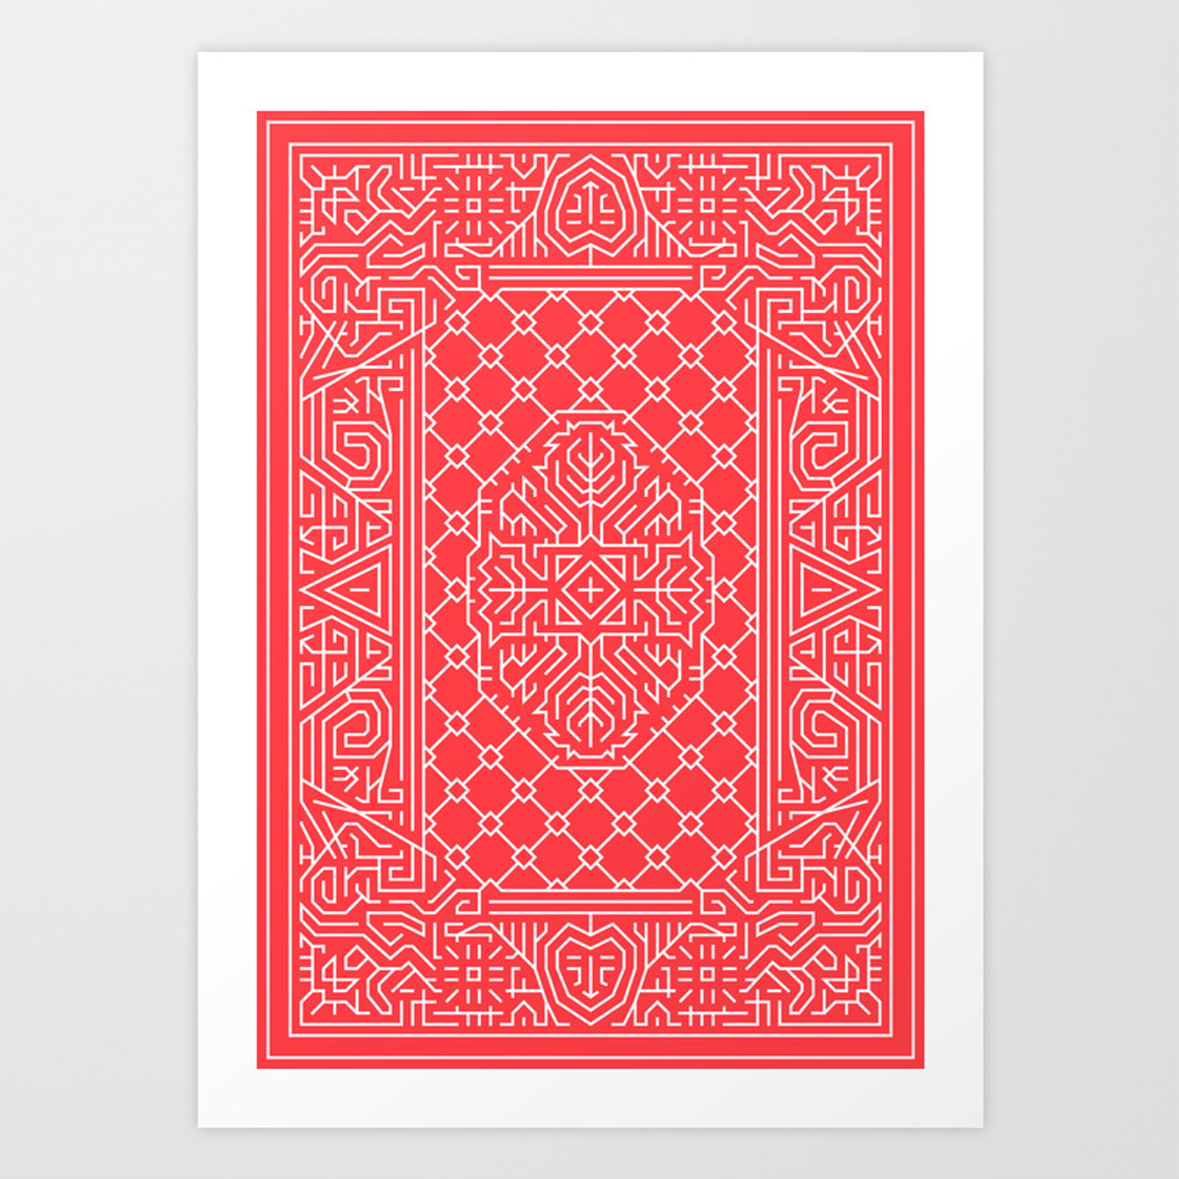
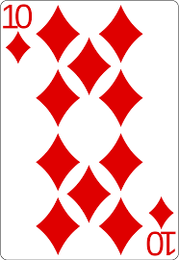
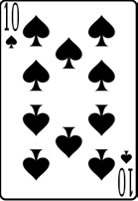
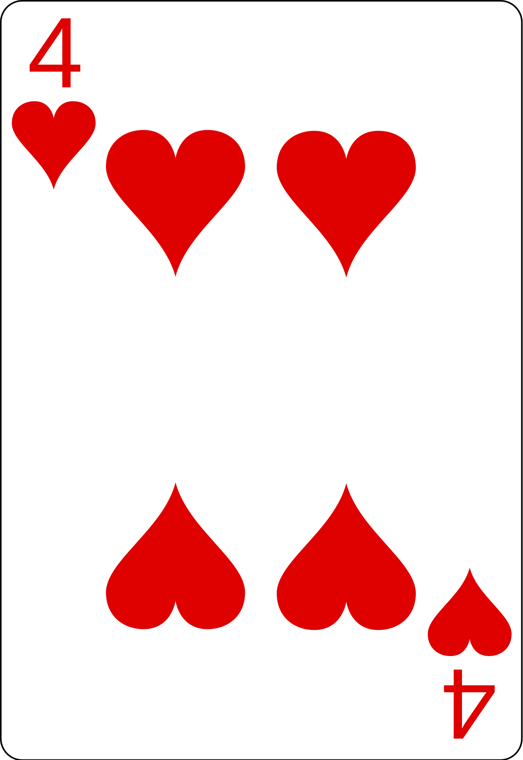
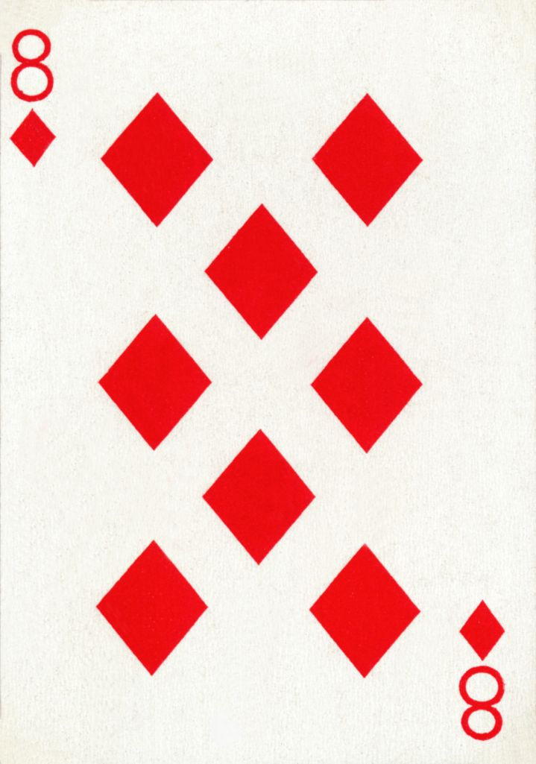
BUST
Sum of Cards = 14
Hit or stand at 14
58% chance total is under 22
Sum of Cards = 22

Slide 4
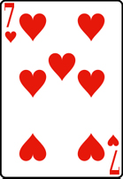
You Win
Sum of Cards = 18
Hit or stand at 18
25% chance total is under 22
I will stand
Dealer will stand at 17

Slide 5

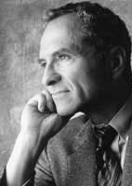
The count
Best odds 49%
Edward Thorp wrote “Beat the Dealer” published in 1962
2-6: count +=1
7-9: no change
1 or 10: count -=1

Slide 6
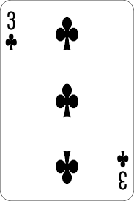
Count += 1
Count = 2
Count = 0
Count += 1

Slide 7
Why is it important
The higher the count the more you bet
Higher count means more 10’s and 1’s
Better chance at a natural blackjack (1.5 * the payout) or high card total
Dealer has to hit 12-16 or stiff hands

Slide 8
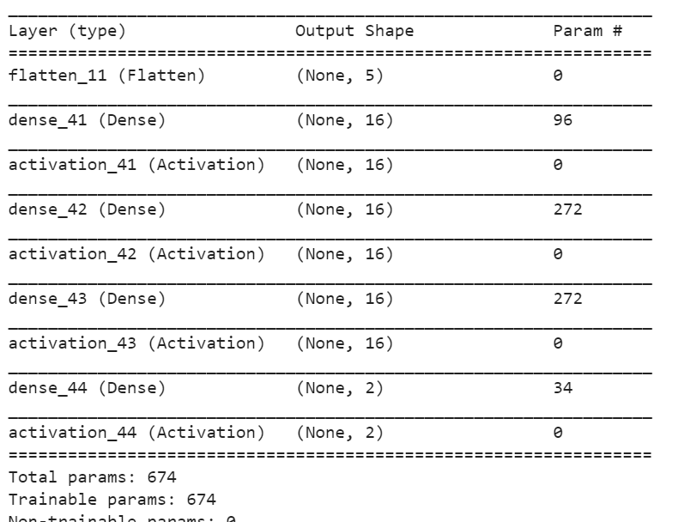
Reinforcement learning
DQN agent
Given an action and observation space
Trying to maximize a reward
Lambda callback to track rewards

Slide 9
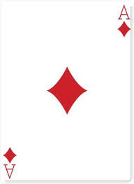
Observation Space – Regular notebook
Usable Ace == True
Sum or its hand == 18 or 8
Dealers face card == 3

Slide 10
Action Space – Regular notebook
Usable Ace == True
Sum or its hand == 18 or 8
Dealers face card == 3
Hit or Stand

Slide 11
Observation and action space for counting cards
Observation space
Count of the cards (ex: +4)
Length of the deck (ex: 72 cards left in the deck)
Action space
Amount to bet Chosen before cards are dealt
Minimum bet == 5
Max bet == 500

Slide 12
Limited deck
The count is updated as cards are dealt
If the deck is empty it is returned to a 52 card deck and the count is set back to 0
Target model update

Slide 13
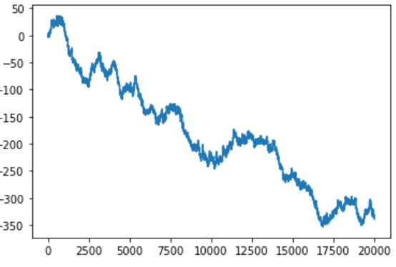
Results – Regular Agent
If we treat the reward like betting a single dollar every game:
20,000 games
Regular:
- 339

Slide 14
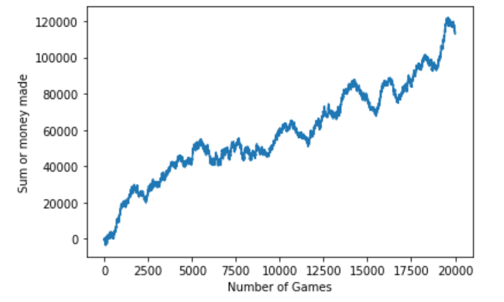
Results – Counting Agent
Agent Choses bet:
20,000 games
Regular:
113,115 dollars made

Slide 15
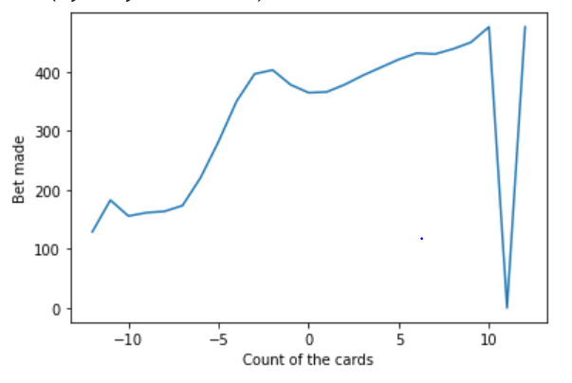
Average bet
Bet rose with count
Agent never shied away from a bet at any count

Slide 16
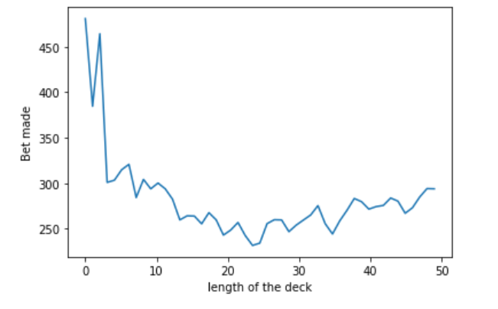
Average bet
Huge bets when length of the deck was shorter

Slide 17
Modern day game play
Casinos play with multiple deck
Count can still be kept
Running count = true count / number of decks left

Slide 18
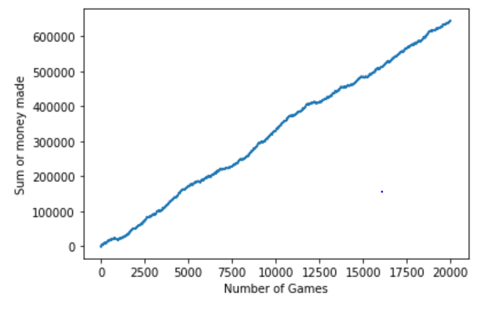
New model
6 decks
Running count
643461

